Slide 1
HATE SPEECH DETECTION
USING MACHINE LEARNING
LIKITH GOSHIKE
DATA SCIENCE INTERN
COINCENT

Slide 2
ABSTRACT
In recent years, the rise of social media platforms and online forums has led to an unprecedented surge in user-generated content, some of which include harmful and offensive language. Hate speech, which provides for abusive, threatening, or demeaning expressions, can have severe societal consequences, fostering division and perpetuating discrimination. This research focuses on developing a robust machine-learning system for detecting hate speech in text-based content. Leveraging supervised learning techniques, we explore a range of classification algorithms including logistic regression, support vector machines (SVM), and deep learning methods such as neural networks. A dataset composed of labeled text—categorized as hate speech, offensive language, or neutral—is used for training and evaluation. Feature extraction methods such as TF-IDF and word embeddings (Word2Vec, GloVe) represent the textual data in a format suitable for machine learning models.

Slide 3
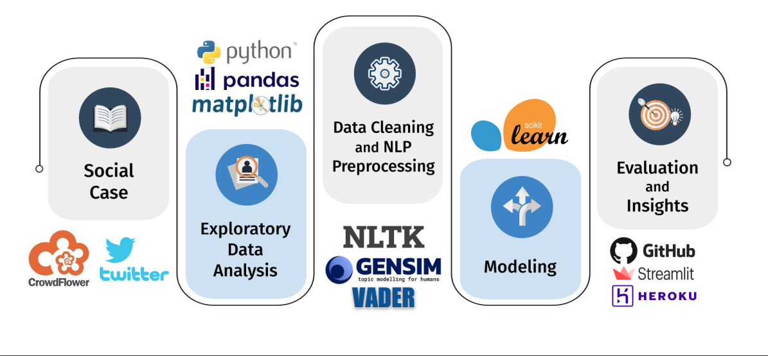
OBJECTIVE-PROCESS

Slide 4
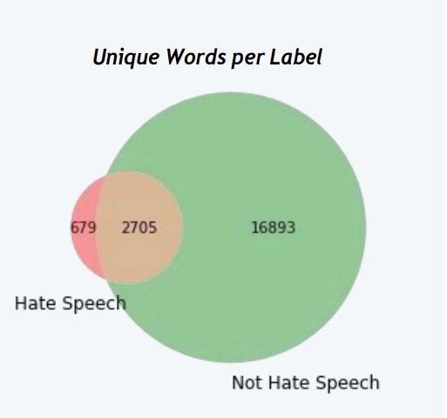
INTRODUCTION
Hate speech is a growing concern in today's digital age, especially with the proliferation of online platforms where individuals can freely express their opinions. Hate speech refers to any form of communication, whether spoken, written, or behavioral, that vilifies, discriminates, or expresses hostility against individuals or groups based on characteristics such as race, religion, gender, ethnicity, sexual orientation, or disability.
Machine learning (ML) offers powerful techniques for automating the detection of hate speech by leveraging patterns in data. With advances in natural language processing (NLP), ML models can be trained to identify harmful content by analyzing the underlying linguistic features of text, including word usage, sentence structure, and context. These models are then able to flag or filter out hate speech in real-time, improving the ability of platforms to enforce community guidelines and foster a positive user experience.

Slide 5
DATA ANALYSIS
What are the popular hastags of each tweet type?
What is the overall polarity of the tweets?
What are the Linguistic differences between hate speech and offensive language ?

Slide 6
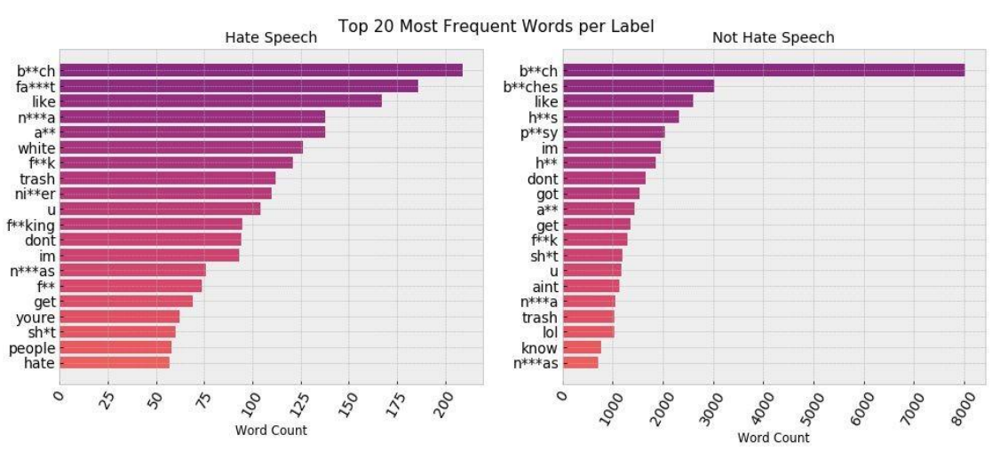
What are the linguistic differences between hate speech and offensive language

Slide 7
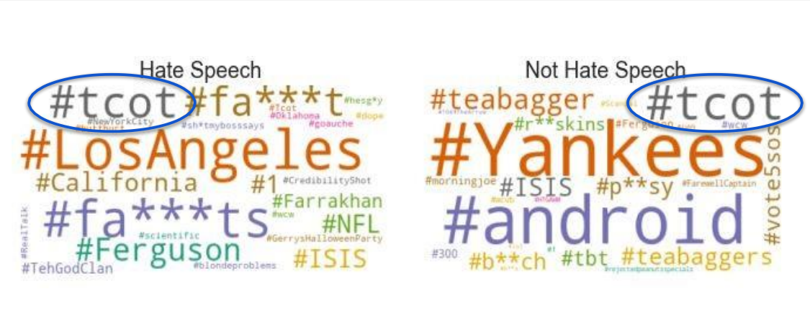
What are the popular hashtags of each tweet type ?

Slide 8
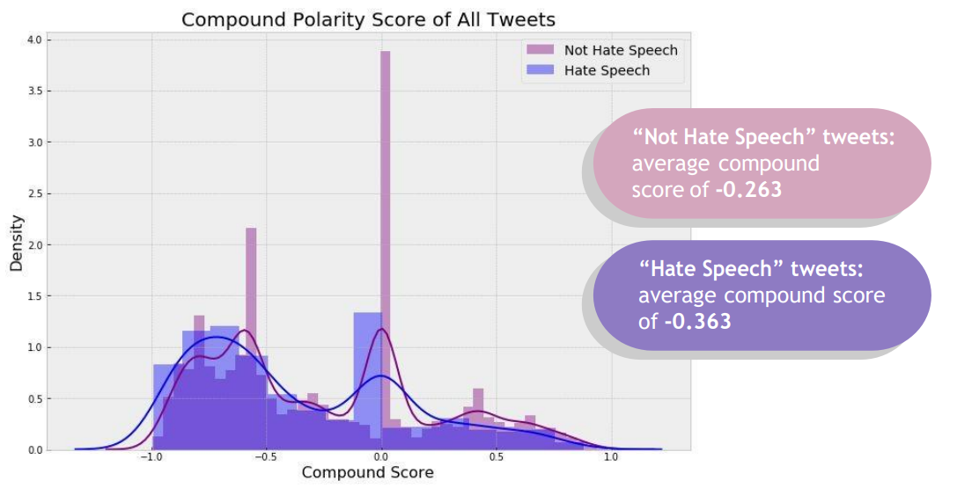
What is the overall polarity of the tweets?

Slide 9
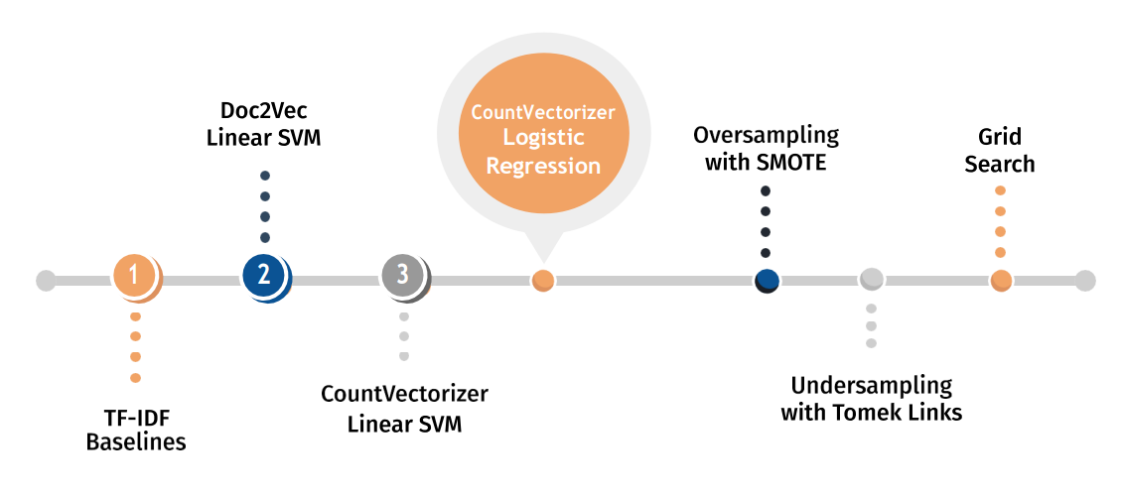
METHODOLOGY

Slide 10
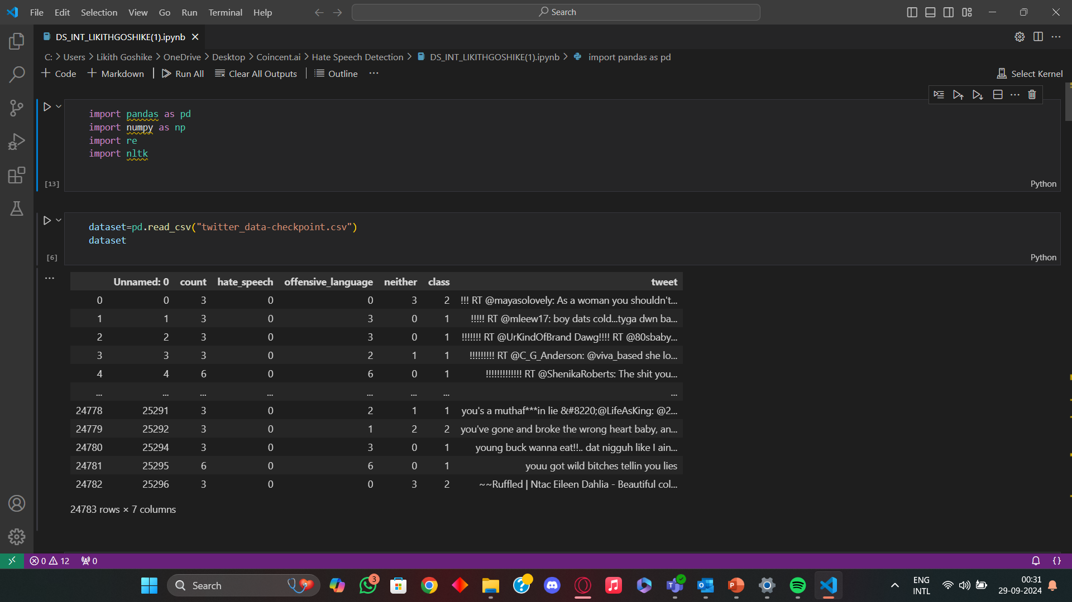
CODE

Slide 11
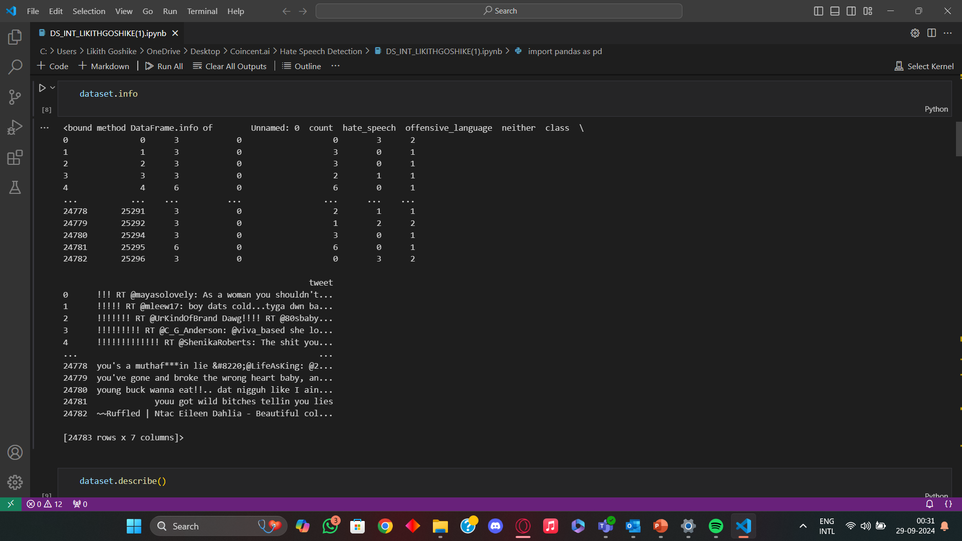
CODE

Slide 12
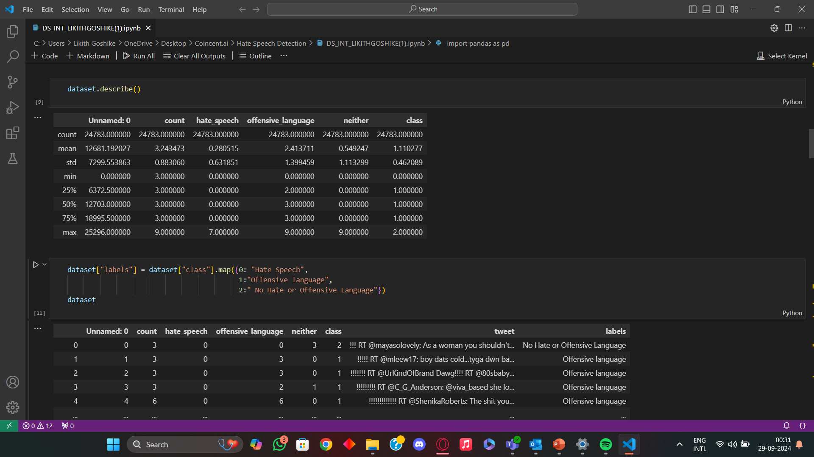
CODE

Slide 13

CODE

Slide 14

CODE

Slide 15

CODE

Slide 16
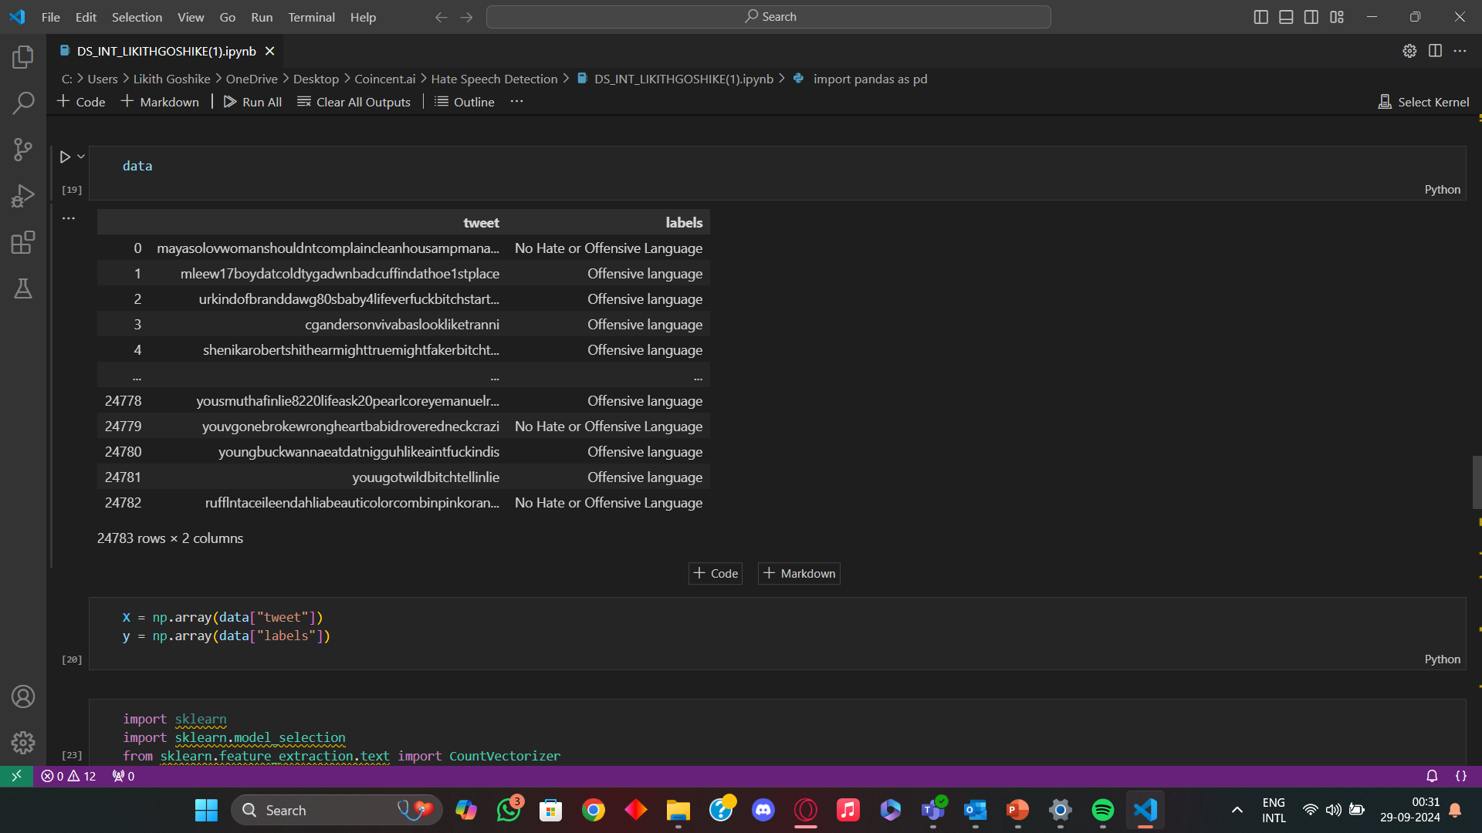
CODE

Slide 17

CODE

Slide 18

CODE

Slide 19

CODE

Slide 20

CODE

Slide 21

CODE

Slide 22
Conclusion
The application of machine learning (ML) in hate speech detection has demonstrated significant potential in identifying and mitigating harmful online content. Through the use of advanced techniques such as natural language processing (NLP), deep learning, and traditional ML algorithms like support vector machines (SVM), decision trees, or neural networks, we can achieve automated and scalable solutions for detecting hate speech across social media platforms, forums, and online discussions.
While machine learning models offer substantial accuracy in classifying hate speech, challenges remain. Bias in training datasets, difficulties in handling nuanced language (e.g., sarcasm or coded language), and the need for continuous adaptation to evolving forms of hate speech are notable obstacles. Furthermore, there are ethical considerations, particularly in ensuring that automated systems do not infringe on free speech or disproportionately target certain groups.
In conclusion, while machine learning significantly improves the speed and accuracy of hate speech detection, future research and development should aim at refining models to be more inclusive, adaptable, and ethically sound.

